Slide 1
Cloud Computing
Dr. Md. Nasim Adnan

Slide 2
Securing the Cloud
The Internet was designed primarily to be resilient; it was not designed to be secure. Any distributed application has a much greater attack surface than an application that is closely held on a Local Area Network.
Cloud computing has all the vulnerabilities associated with Internet applications, and additional vulnerabilities arise from pooled, virtualized, and outsourced resources.

Slide 3
The following areas of cloud computing is uniquely troublesome:
Risks
Privacy
Auditing
Data integrity
Legal compliance
Regulatory compliance

Slide 4
Risk area
Risks in any cloud deployment are dependent upon the particular cloud service model chosen and the type of cloud on which you deploy your applications. In order to evaluate risks, you need to perform the following analysis:
Determine which resources (data, services, or applications) you are planning to move to the cloud.
Determine the sensitivity of the resource to risk. Risks that need to be evaluated are loss of privacy, unauthorized access by others, loss of data, and interruptions in availability.
Determine the risk associated with the particular cloud type for a resource. Cloud types include public, private (both external and internal), hybrid, and shared community types. With each type, you need to consider where data and functionality will be maintained.

Slide 5
Take into account the particular cloud service model that you will be using. Different models such as IaaS, SaaS, and PaaS require their customers to be responsible for security at different levels of the service stack.
If you have selected a particular cloud service provider, you need to evaluate its system to understand how data is transferred, where it is stored, and how to move data both in and out of the cloud. You may want to consider building a flowchart that shows the overall mechanism of the system you are intending to use or are currently using.

Slide 6
Cloud Security Alliance (CSA)
The CSA partitions its guidance into a set of operational domains:
Governance and enterprise risk management
Legal and electronic discovery
Compliance and audit
Information lifecycle management
Portability and interoperability
Traditional security, business continuity, and disaster recovery
Datacenter operations
Incidence response, notification, and remediation
Application security
Encryption and key management
Identity and access management
Virtualization

Slide 7
Security Service Boundary
Recall the Cloud Reference Model discussed earlier where IaaS is the lowest level service, with PaaS and SaaS the next two services above.
As you move upward in the stack, each service model inherits the capabilities of the model beneath it, as well as all the inherent security concerns and risk factors.
IaaS supplies the infrastructure; PaaS adds application development frameworks; and SaaS is the user interface.
As you ascend the stack, IaaS has the least levels of integrated functionality and the lowest levels of integrated security, and SaaS has the most.
Each different type of cloud service delivery model creates a security boundary at which the cloud service provider’s responsibilities end and the customer’s responsibilities begin.
Any security mechanism below the security boundary must be built into the system, and any security mechanism above must be maintained by the customer. As you move up the stack, it becomes more important to make sure that the type and level of security is part of your Service Level Agreement.

Slide 8
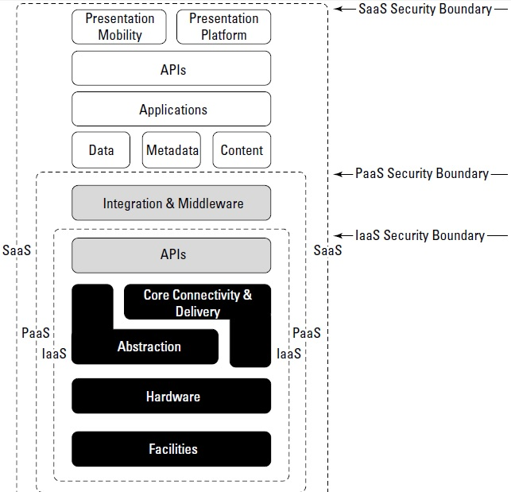

Slide 9
Securing Data
Securing data sent to, received from, and stored in the cloud is the single largest security concern that most organizations should have with cloud computing. As with any WAN traffic, you must assume that any data can be intercepted and modified.
That’s why, as a matter of course, traffic to and from a cloud service provider is encrypted. This is as true for general data as it is for any passwords or account IDs.
These are the key mechanisms for protecting data mechanisms:
Access control
Authentication
Authorization
Auditing
Whatever service model you choose should have mechanisms operating in all four areas that meet your security requirements, whether they are operating through the cloud service provider or your own local infrastructure.

Slide 10
Storage Location and Tenancy
Some cloud service providers negotiate as part of their Service Level Agreements to contractually store and process data in locations that are predetermined by their contract. Not all do. If you can get the commitment for specific data site storage, then you also should make sure the cloud vendor is under contract to conform to local privacy laws.
Most cloud service providers store data in an encrypted form. While encryption is important and effective, it does present its own set of problems. When there is a problem with encrypted data, the result is that the data may not be recoverable. It is worth considering what type of encryption the cloud provider uses and to check that the system has been planned and tested by security experts.

Slide 11
Encryption
Strong encryption technology is a core technology for protecting data in transit to and from the cloud as well as data stored in the cloud.
The goal of encrypted cloud storage is to create a virtual private storage system that maintains confidentiality and data integrity while maintaining the benefits of cloud storage: ubiquitous, reliable, shared data storage.
Encryption should separate stored data (data at rest) from data in transit. Although encryption protects your data from unauthorized access, it does nothing to prevent data loss.
Indeed, a common means for losing encrypted data is to lose the keys that provide access to the data. Therefore, you need to approach key management seriously. Keys should have a defined lifecycle.

Slide 12
Auditing and Compliance
Logging is the recording of events into a repository; auditing is the ability to monitor the events to understand performance. Logging and auditing is an important function because it is not only necessary for evaluation performance, but it is also used to investigate security and when illegal activity has been perpetrated. Logs should record system, application, and security events, at the very minimum.
Logging and auditing are unfortunately one of the weaker aspects of cloud computing service offerings. Cloud service providers often have proprietary log formats that you need to be aware of. Whatever monitoring and analysis tools you use need to be aware of these logs and able to work with them.
Often, providers offer monitoring tools of their own, many in the form of a dashboard with the potential to customize the information you see through either the interface or programmatically using the vendor’s API. You need to make full use of those built-in services.

Slide 13
Identity and Presence
Identity management is a primary mechanism for controlling access to data in the cloud, preventing unauthorized uses, maintaining user roles, and complying with regulations.
We can consider presence to be the mapping of an authenticated identity to a known location. Presence is important in cloud computing because it adds context that can modify services and service delivery.
Cloud computing requires the following:
That you establish an identity
That the identity be authenticated
That the authentication be portable
That authentication provide access to cloud resources

Slide 14
When applied to a number of users in a cloud computing system, these requirements describe systems that must provision identities, provide mechanisms that manage credentials and authentication, allow identities to be federated, and support a variety of user profiles and access policies.
Automating these processes can be a major management task, just as they are for on-premises operations.

Slide 15
One technique for containing risk and maintaining security is to have “golden” system image references that you can return to when needed. The ability to take a system image off-line and analyze the image for vulnerabilities or compromise is invaluable. The compromised image is a primary forensics tool.
Many cloud providers offer a snapshot feature that can create a copy of the client’s entire environment; this includes not only machine images, but applications and data, network interfaces, firewalls, and switch access. If you feel that a system has been compromised, you can replace that image with a known good version and contain the problem.

